Slide 1




Comparative analysis of neural methods for entity normalization in the biological field
Soutenance de stage - M1 bioinformatique
Antoine Toffano
Encadrants : Arnaud Ferré | Louise Deléger

Slide 2

Introduction
Context: Information extraction
Entity recognition
Bacteria
Habitat
“E. Coli and L. Lactis. are anaerobic bacterium that are commonly found in the lower-intestine of humans”

Slide 3
Introduction
Context: Information extraction
Entity normalization
NCBI:562
Label: Escherichia Coli
NCBI:1246
Label: Lactococcus Lactis
OBT:002810
Label : intestine
OBT:002488
Label: human
Bacteria
Habitat
“E. Coli and L. Lactis. are anaerobic bacterium that are commonly found in the lower-intestine of humans”

Slide 4
Introduction
Context: Information extraction
Ontology of bacterial habitats
is_a
OBT:00001
Label :
“microbial habitat”
OBT:03188
Label : “living organism”
is_a
is_a
OBT:02488
Labels : “human”
“homo sapiens”
OBT:00014
Label : “part of
living organism”
is_a
is_a
is_a
OBT:03188
Label : “child”
OBT:03245
Label : “adult human”
OBT:002810
Label : “intestine”

Slide 5
Introduction
Context: Information extraction
Bacteria
Habitat
“E. Coli and L. Lactis. are anaerobic bacterium that are commonly found in the lower-intestine of humans”
Mention
“E.coli”
“L.Lactis”
“lower-intestine”
“human”

Slide 6
Introduction
Context: Information extraction
Bacteria
Habitat
“E. Coli and L. Lactis. are anaerobic bacterium that are commonly found in the lower-intestine of humans”
Mention | Label(s) | Identifier
“E.coli” | “Escherichia Coli” | NCBI:562
“L.Lactis” | “Lactococcus Lactis” | NCBI:1246
“lower-intestine” | “Intestine” | OBT:02810
“human” | “Human”, “homo sapiens” | OBT:02488

Slide 7




Objectives
Evaluate two methods on different datasets
NCBI disease
BioSyn
1
Lightweight
?
Bacteria biotope
2
Evaluate
The reproducibility
The robustness
1
2
Phenotype Habitat

Slide 8
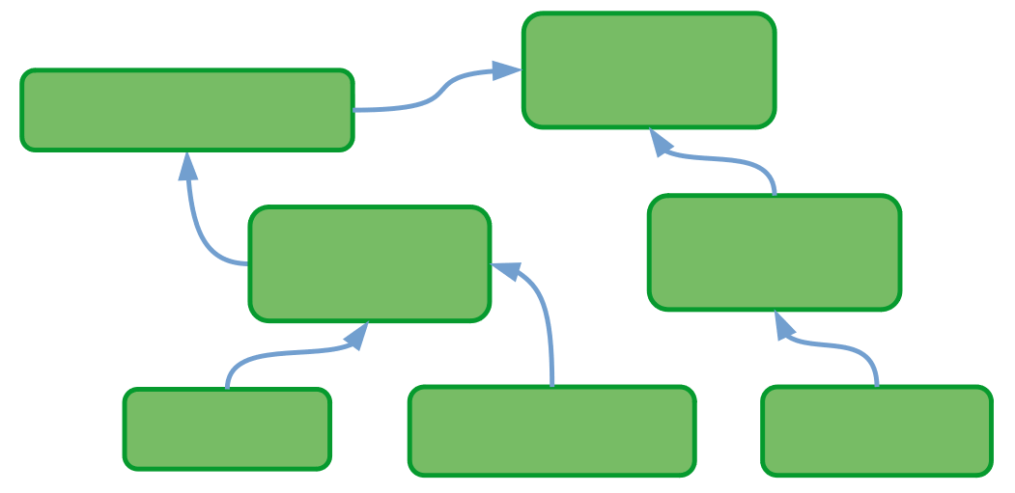
Methodology
Vectorization
“intestine”
“skin”
“mouth”
“water”
…
“soil”
ID150
ID151
ID154
ID158
...
ID432
“the lower intestine”

Slide 9
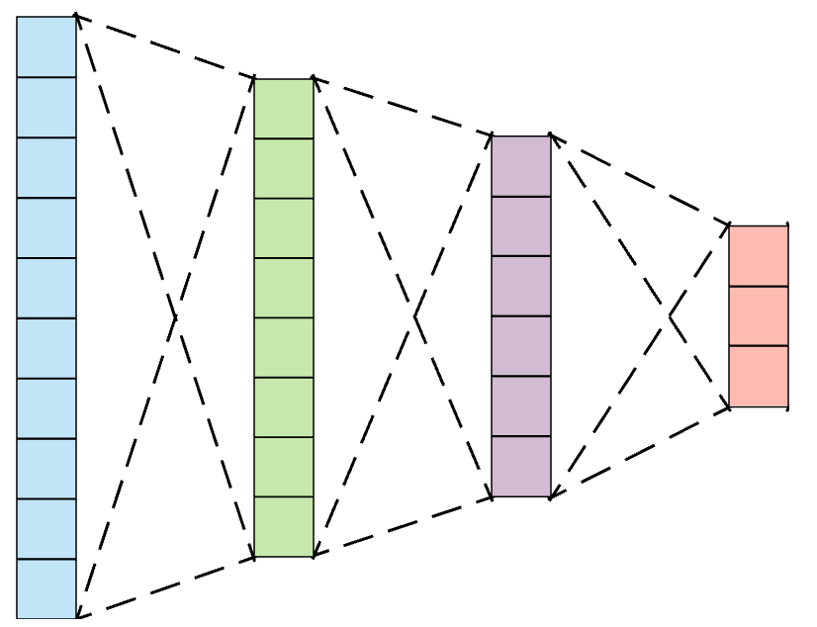
Methodology
Vectorization
“intestine”
“skin”
“mouth”
“water”
…
“soil”
water
intestine
gut
mouth
skin
“gut”
soil

Slide 10
Methodology
Overview
Mention
“gut”
Score
ID150
ID151
ID154
ID158
...
ID432
“intestine”
“skin”
“mouth”
“water”
…
“soil”
“intestine”
Candidate

Slide 11

Contributions
https://forgemia.inra.fr/antoine.toffano/entity-norm
Parsing and formatting data
Bacteria
Biotope 4
BioSyn
Lightweight
NCBI Disease

Slide 12
Contributions
https://forgemia.inra.fr/antoine.toffano/entity-norm
Parsing and formatting data
Bacteria
Biotope 4
BioSyn
Bacteria
Biotope 4
NCBI Disease
Lightweight
NCBI Disease
Standardize

Slide 13
Contributions
https://forgemia.inra.fr/antoine.toffano/entity-norm
Parsing and formatting data
Bacteria
Biotope 4
BioSyn
Bacteria
Biotope 4
NCBI Disease
Lightweight
NCBI Disease
Standardize
Adapt

Slide 14
Contributions
Lightweight
Preprocessing
“E. Coli is a bacteria. It can be found, among other places, in the human lower-intestine.”
Abbreviation resolution
“Escherichia Coli is a bacteria. It can be found, among other places, in the human lower-intestine.”
Lowercase & remove punctuation
Lowercase & remove punctuation
Context extraction
+
“escherichia coli is a bacteria”
Mention
Context

Slide 15
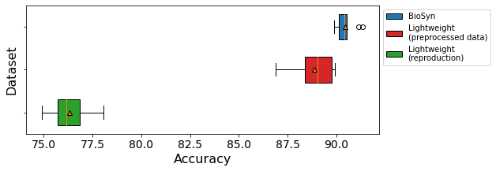
Results
https://forgemia.inra.fr/antoine.toffano/entity-norm
Reproduction
NCBI disease
BioSyn : 91.10 accuracy on NCBI
Lightweight : 89.59 accuracy on NCBI
90.47
88.88
(n = 10)
76.3

Slide 16
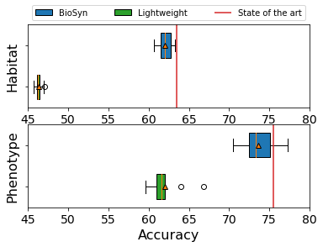
Results
https://forgemia.inra.fr/antoine.toffano/entity-norm
Adaptation to Bacteria Biotope
(n = 10)
46.3
76.3
62.0
73.6

Slide 17
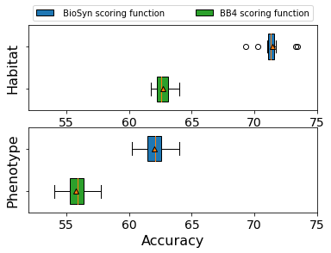
Results
https://forgemia.inra.fr/antoine.toffano/entity-norm
Scoring methods
BioSyn
(n = 10)
62.72
71.41
55.78
62.0

Slide 18
Conclusion
Importance of reproducible results
Standard evaluation
Add more methods
Add more datasets
Define a standard method for evaluation
Next steps

Slide 19
Thank you for your attention!

Slide 20
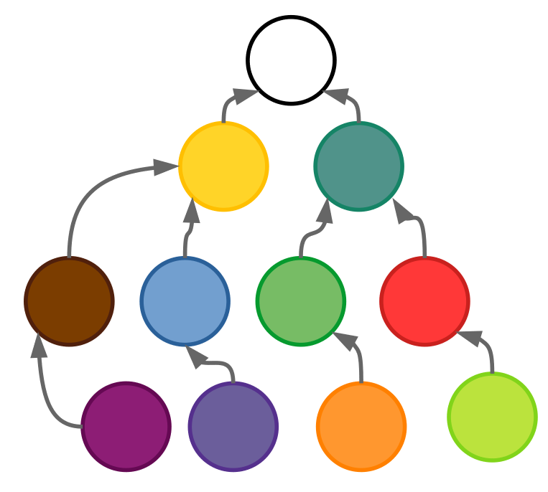
Methodology
Form matching
“intestine”
“skin”
“mouth”
“water”
…
“soil”
ID150
ID151
ID154
ID158
...
ID432
“intestine”

Slide 21
Methodology
Form matching
“intestine”
“skin”
“mouth”
“water”
…
“soil”
ID150
ID151
ID154
ID158
...
ID432
“intestine”

Slide 22
Methodology
Form matching
“intestine”
“skin”
“mouth”
“water”
…
“soil”
ID150
ID151
ID154
ID158
...
ID432
“intestine”
“the lower intestine”

Slide 23
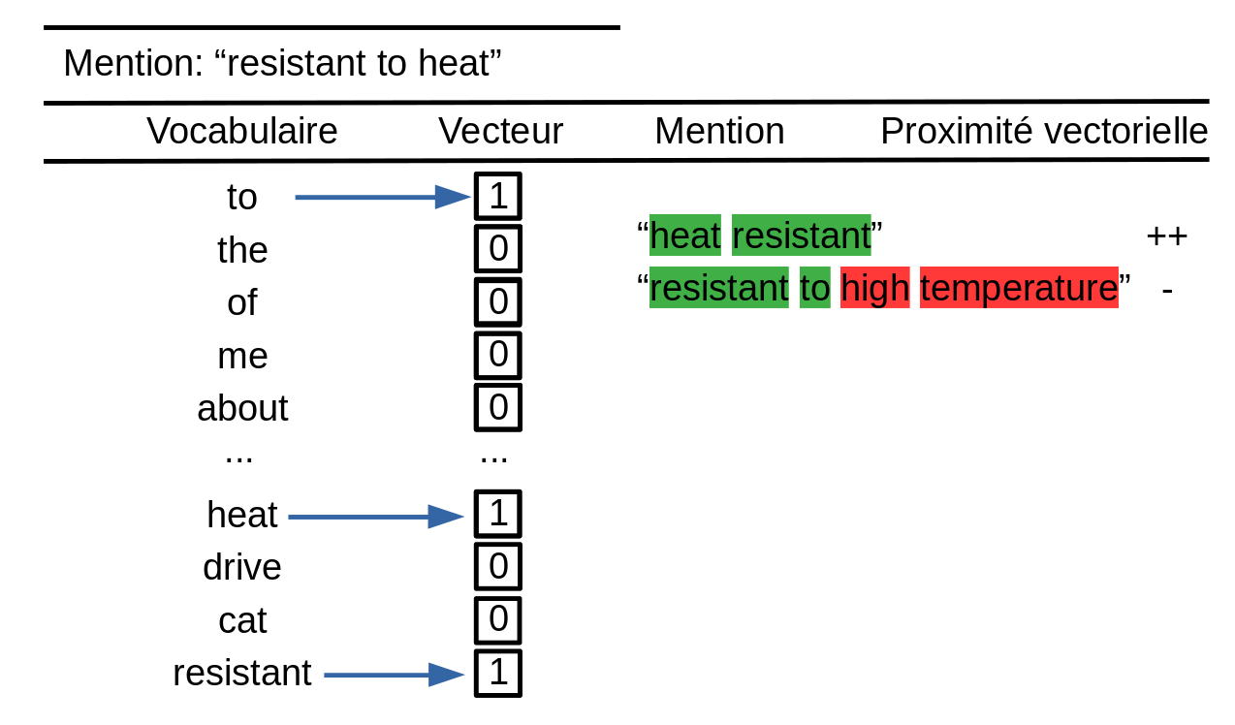
Methodology
Vectorization : bag-of-words

Slide 24
Methodology
Vectorization
“intestine”
“skin”
“mouth”
“water”
…
“soil”
ID150
ID151
ID154
ID158
...
ID432
“intestine”
“the lower intestine”

Slide 25
Methodology
Vectorization
“intestine”
“skin”
“mouth”
“water”
…
“soil”
ID150
ID151
ID154
ID158
...
ID432
“intestine”
“the lower intestine”

Slide 26



Methodology
Vectorization : TF IDF

Slide 27
Methodology
Vectorization
“intestine”
“skin”
“mouth”
“water”
…
“soil”
ID150
ID151
ID154
ID158
...
ID432
“intestine”
“the lower intestine”
“gut”

Slide 28
Methodology
Vectorization
Distributional hypothesis*
Two words sharing a similar context share a similar meaning
 | E.coli | in | the | gut | of | humans
E.coli | 0 | 2 | 2 | 1 | 2 | 2
in | 2 | 0 | 2 | 1 | 2 | 2
the | 2 | 2 | 0 | 1 | 2 | 2
intestine | 1 | 1 | 1 | 0 | 1 | 1
of | 2 | 2 | 2 | 1 | 0 | 2
humans | 2 | 2 | 2 | 1 | 2 | 0
* Harris, Z. "Distributional hypothesis." Word World 10.23 (1954): 146-162.

Slide 29
Methodology
Machine learning
Compressed representation
BioBERT
Word2Vec

Slide 30

Methods
BioSyn
Mention
“covid19”
Circovirus
Covid-19
…
SARS
a.
Dictionnary of labels
BioBERT
b.
c.
TF-IDF

Slide 31
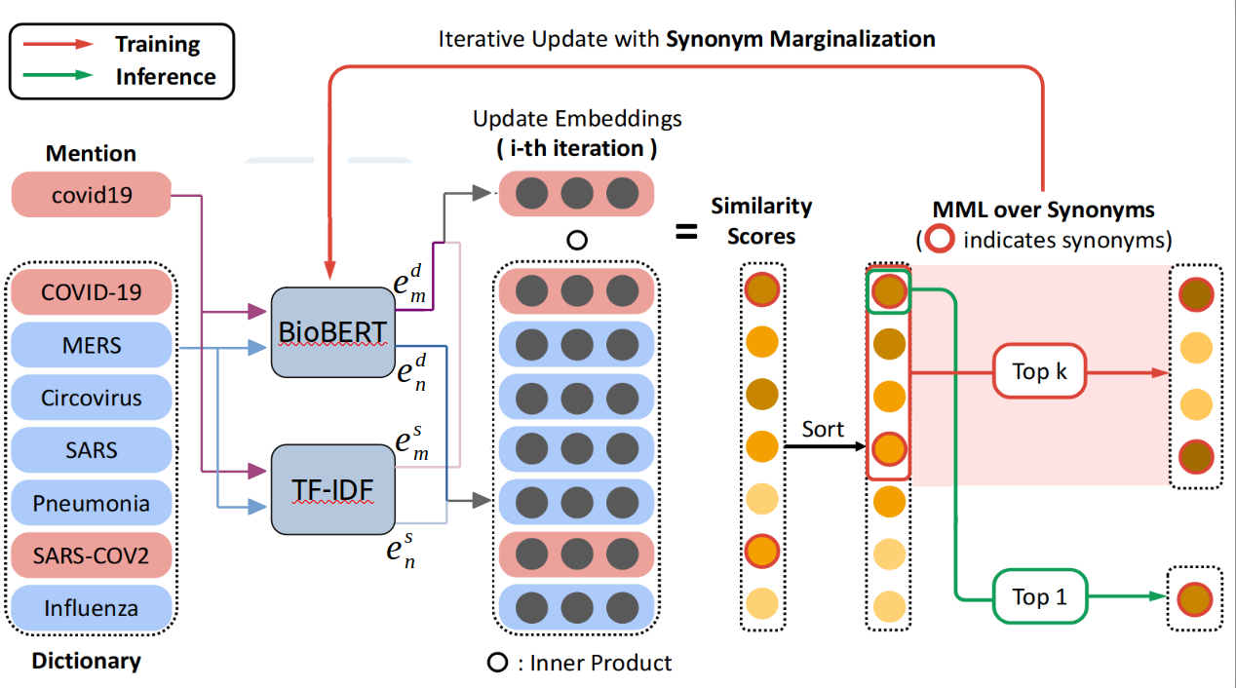
Methods
BioSyn

Slide 32
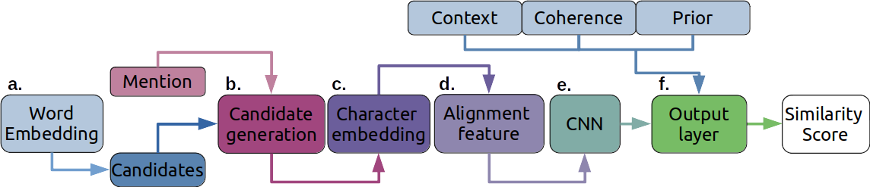
Methods
Lightweight

Slide 33
Methods
Lightweight
Mention
Vecteur W2V
Similarité
Vecteur W2V
Etiquette
...
...
“type”
-0.1
“diabetes”
-0.1
2.3
2.0
1.0
-1.1
2.3
2.0
...
1.0
-1.1
...
“two”
0.12
-0.9
0.3
3.0
3.1
“mellitus”
3.1
4.1
0.2
...
4.6
-3.2
...
“diabetes”
3.1
“type”
-0.3
4.1
0.2
...
4.6
-3.2
-0.3
3.0
1.8
0.2
-0.3
0.2
“two”
-0.3
3.0
1.8
Meilleurs scores de similarité entre et

Slide 34
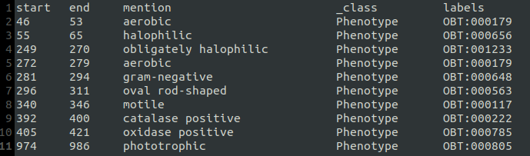
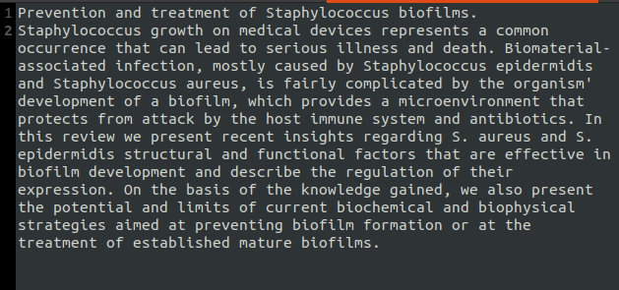
Formats
train
header
Standart format
Format standart
dev
data
test

Slide 35
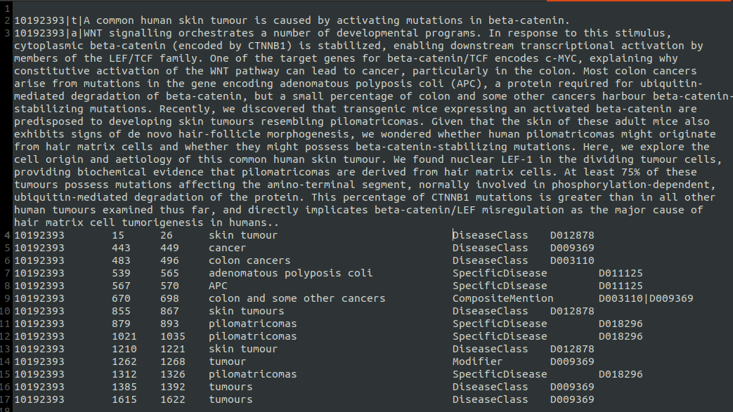
Formats
NCBI format

